Slide 1

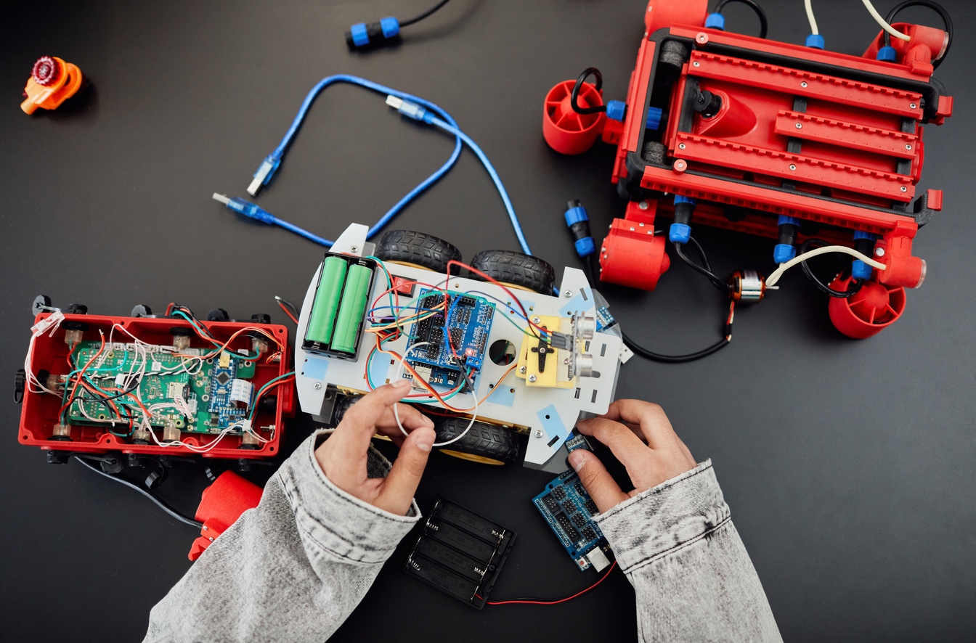
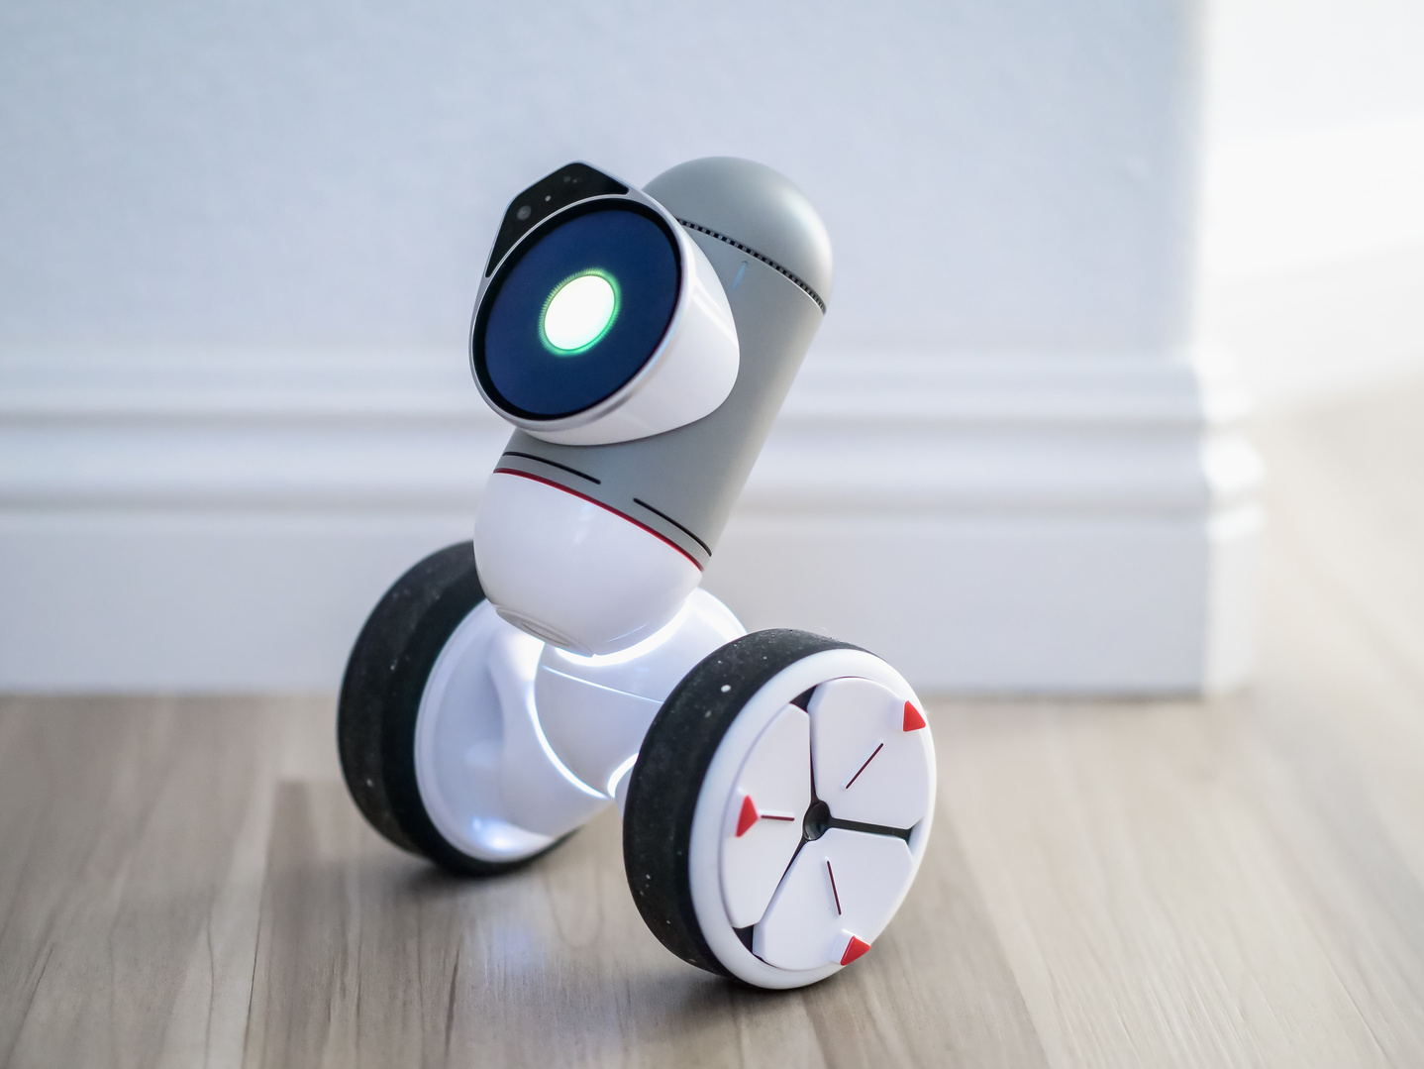
HOME
TITLE
TIMELINE
CONTENT
BUDGET
The Robot!
AI-Based Home Assistant Robo
Team name:- Power Rangers

Slide 2

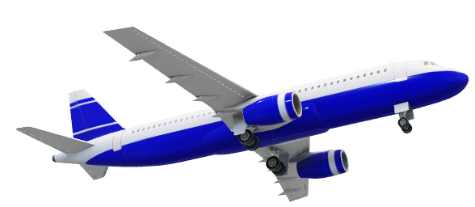
HOME
TITLE
CONTENT
TIMELINE
BUDGET
AI Integration & backend process
The Robot!
AI-Based Home Assistant Robo

Slide 3
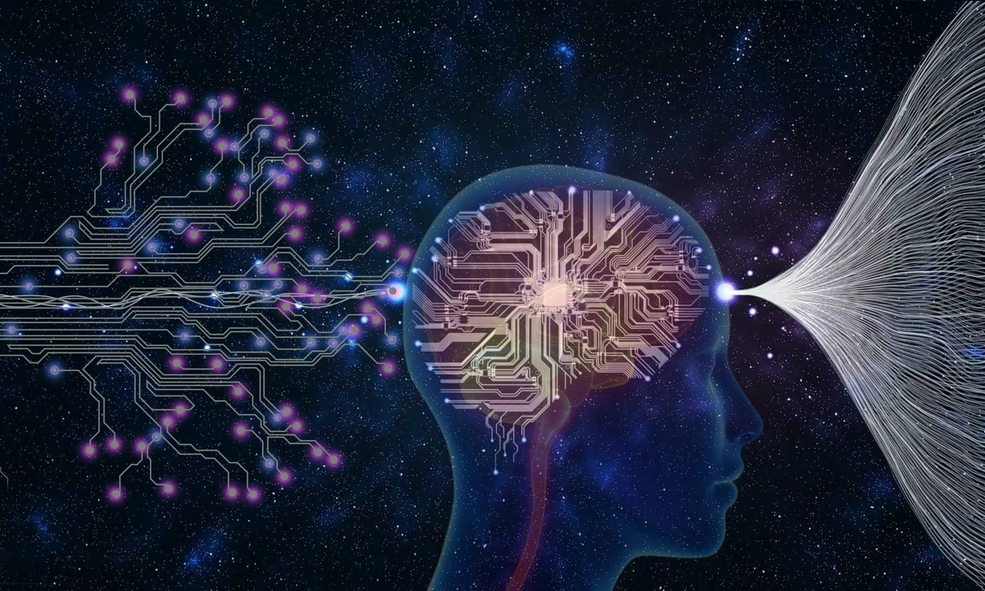
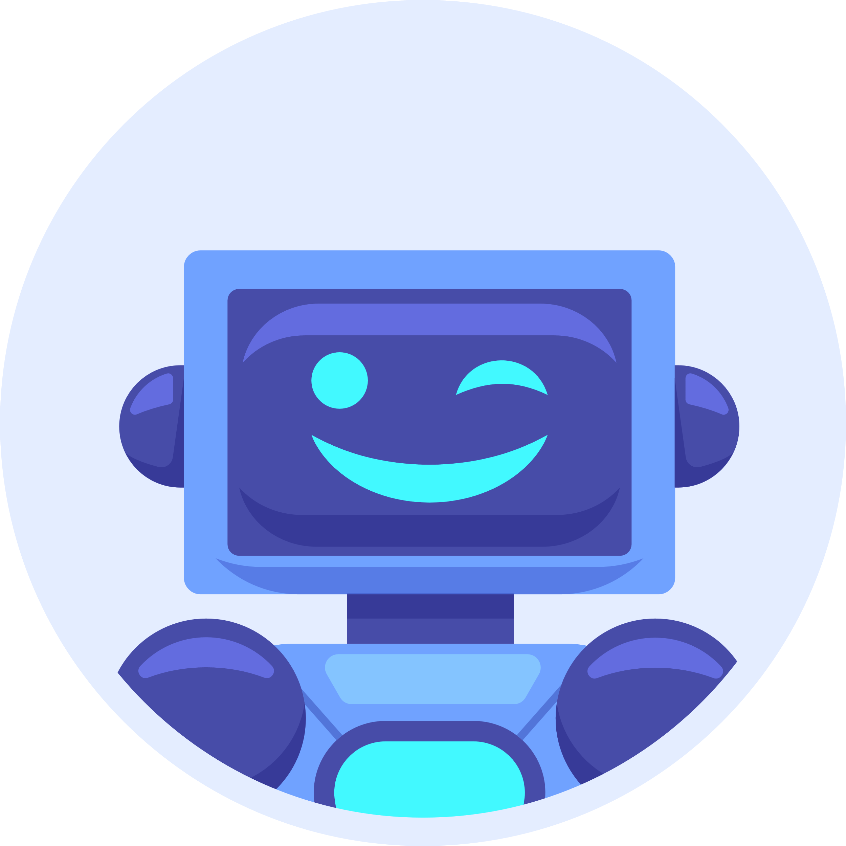
The Robot!
HOME
TITLE
CONTENT
TIMELINE
BUDGET
AI-Based Home Assistant Robo
Table of Content

Slide 4
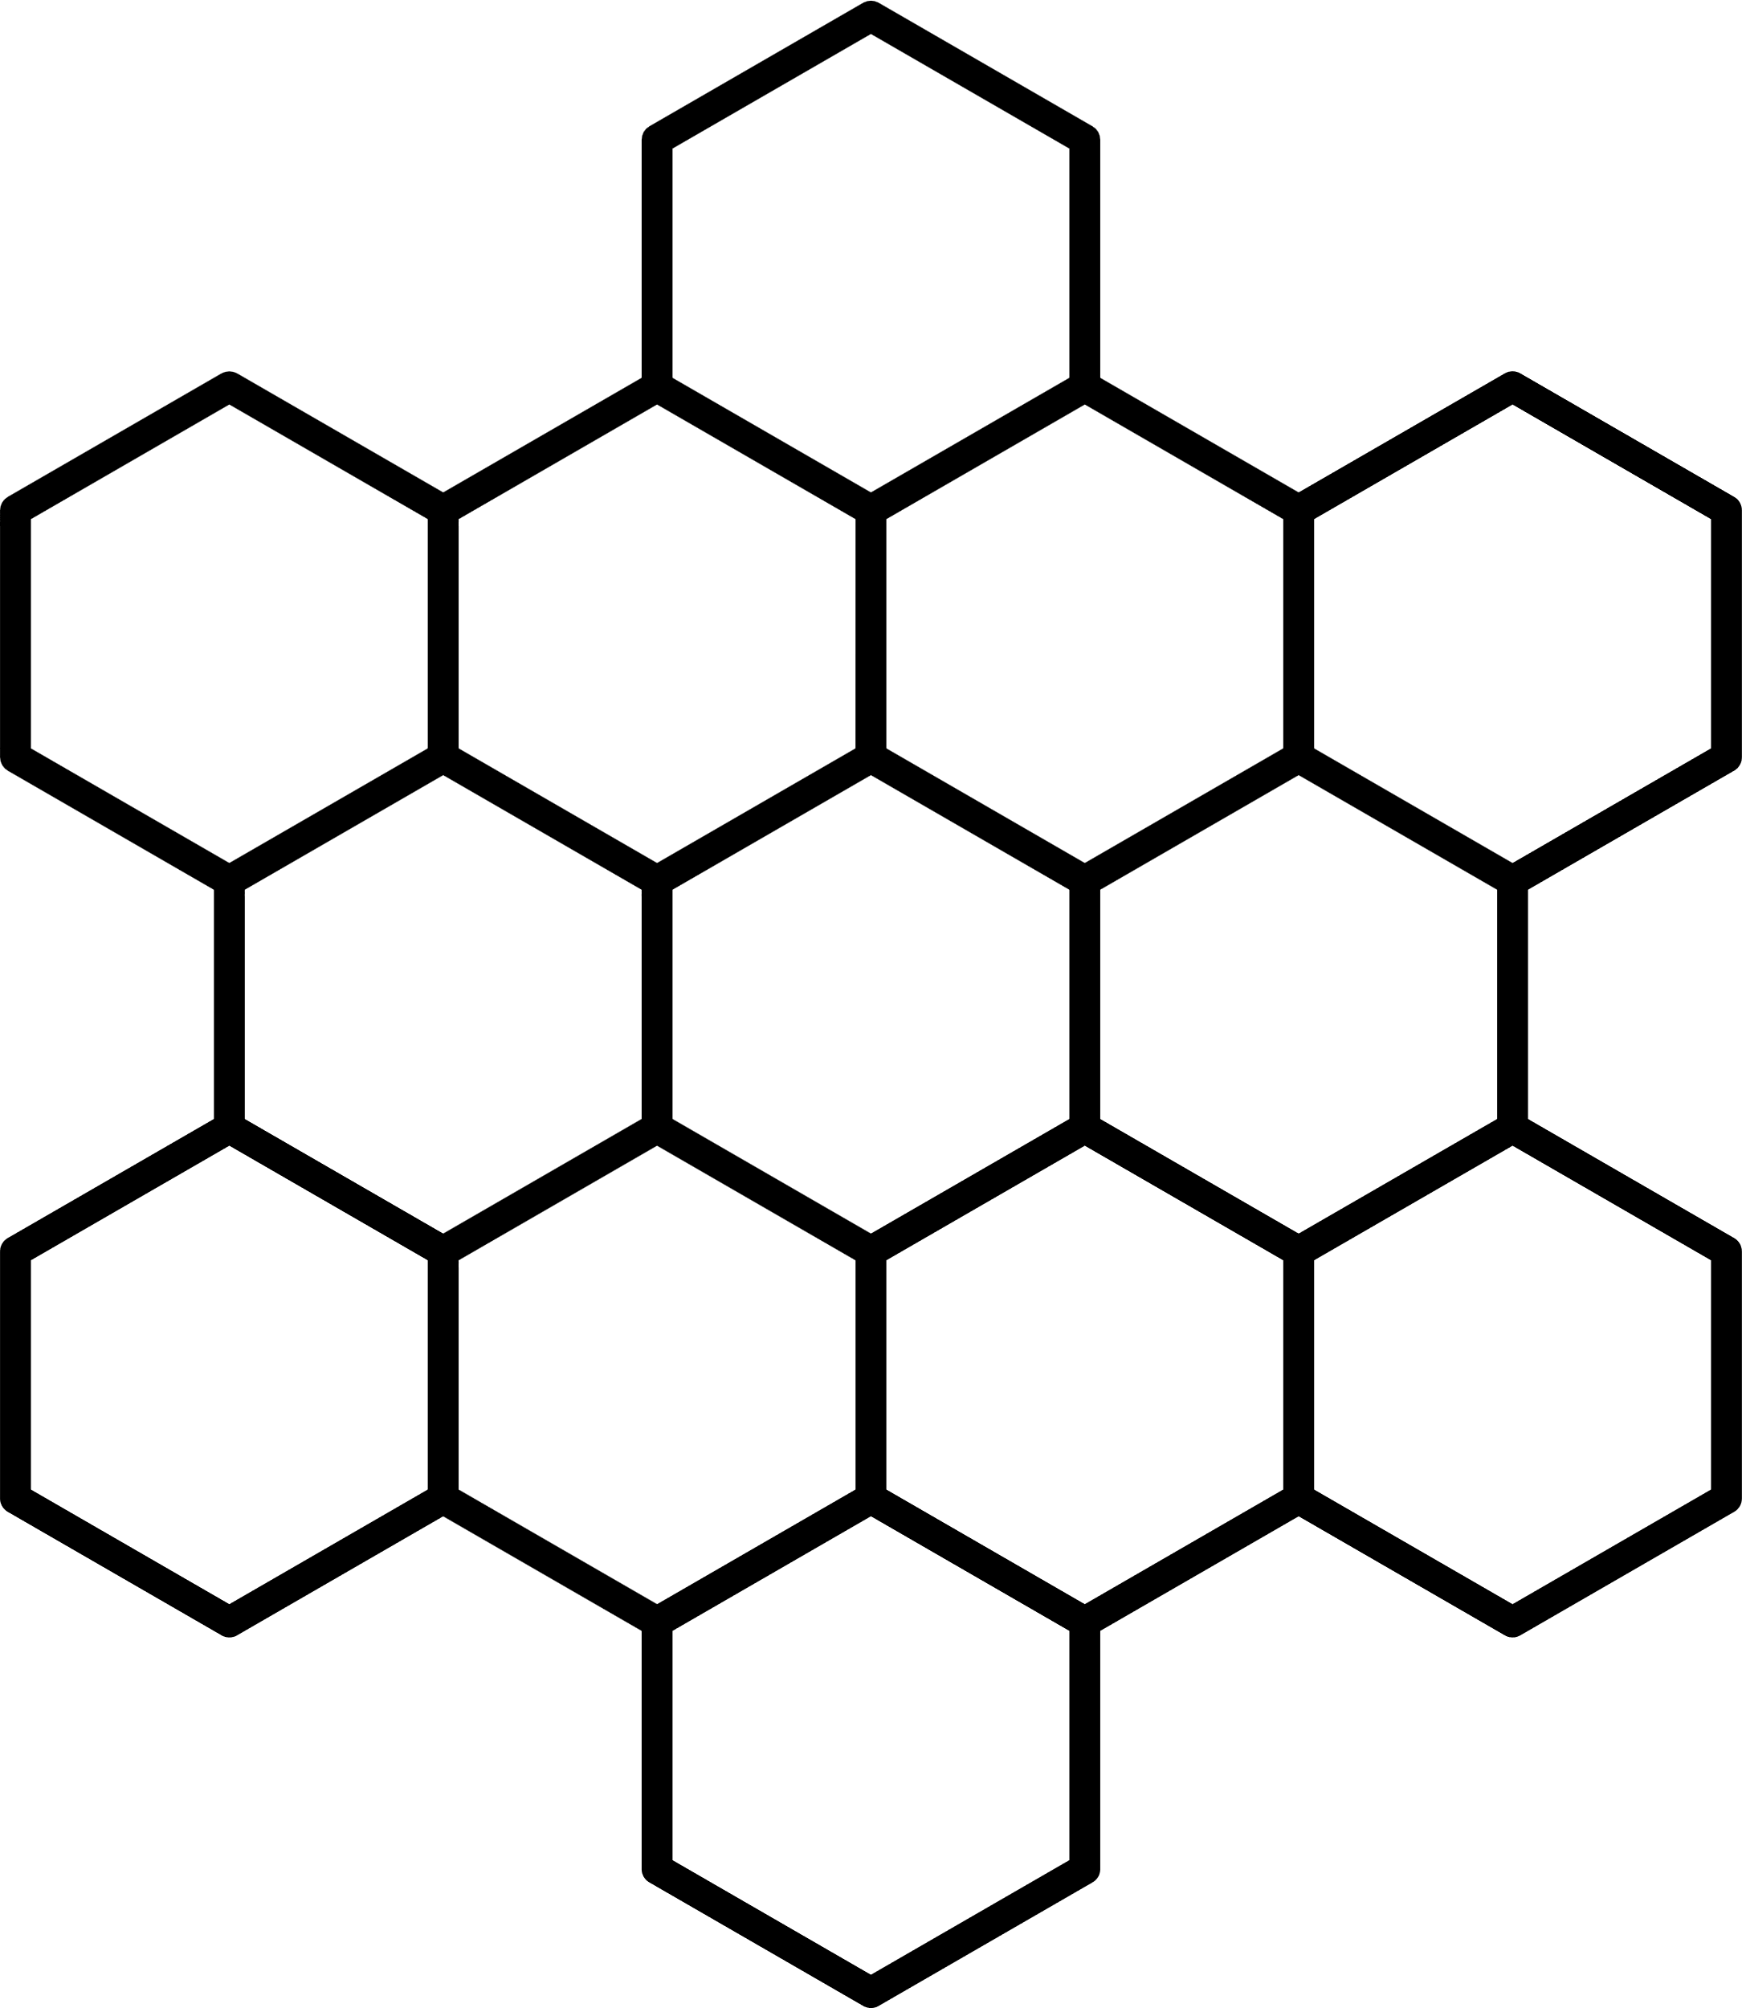
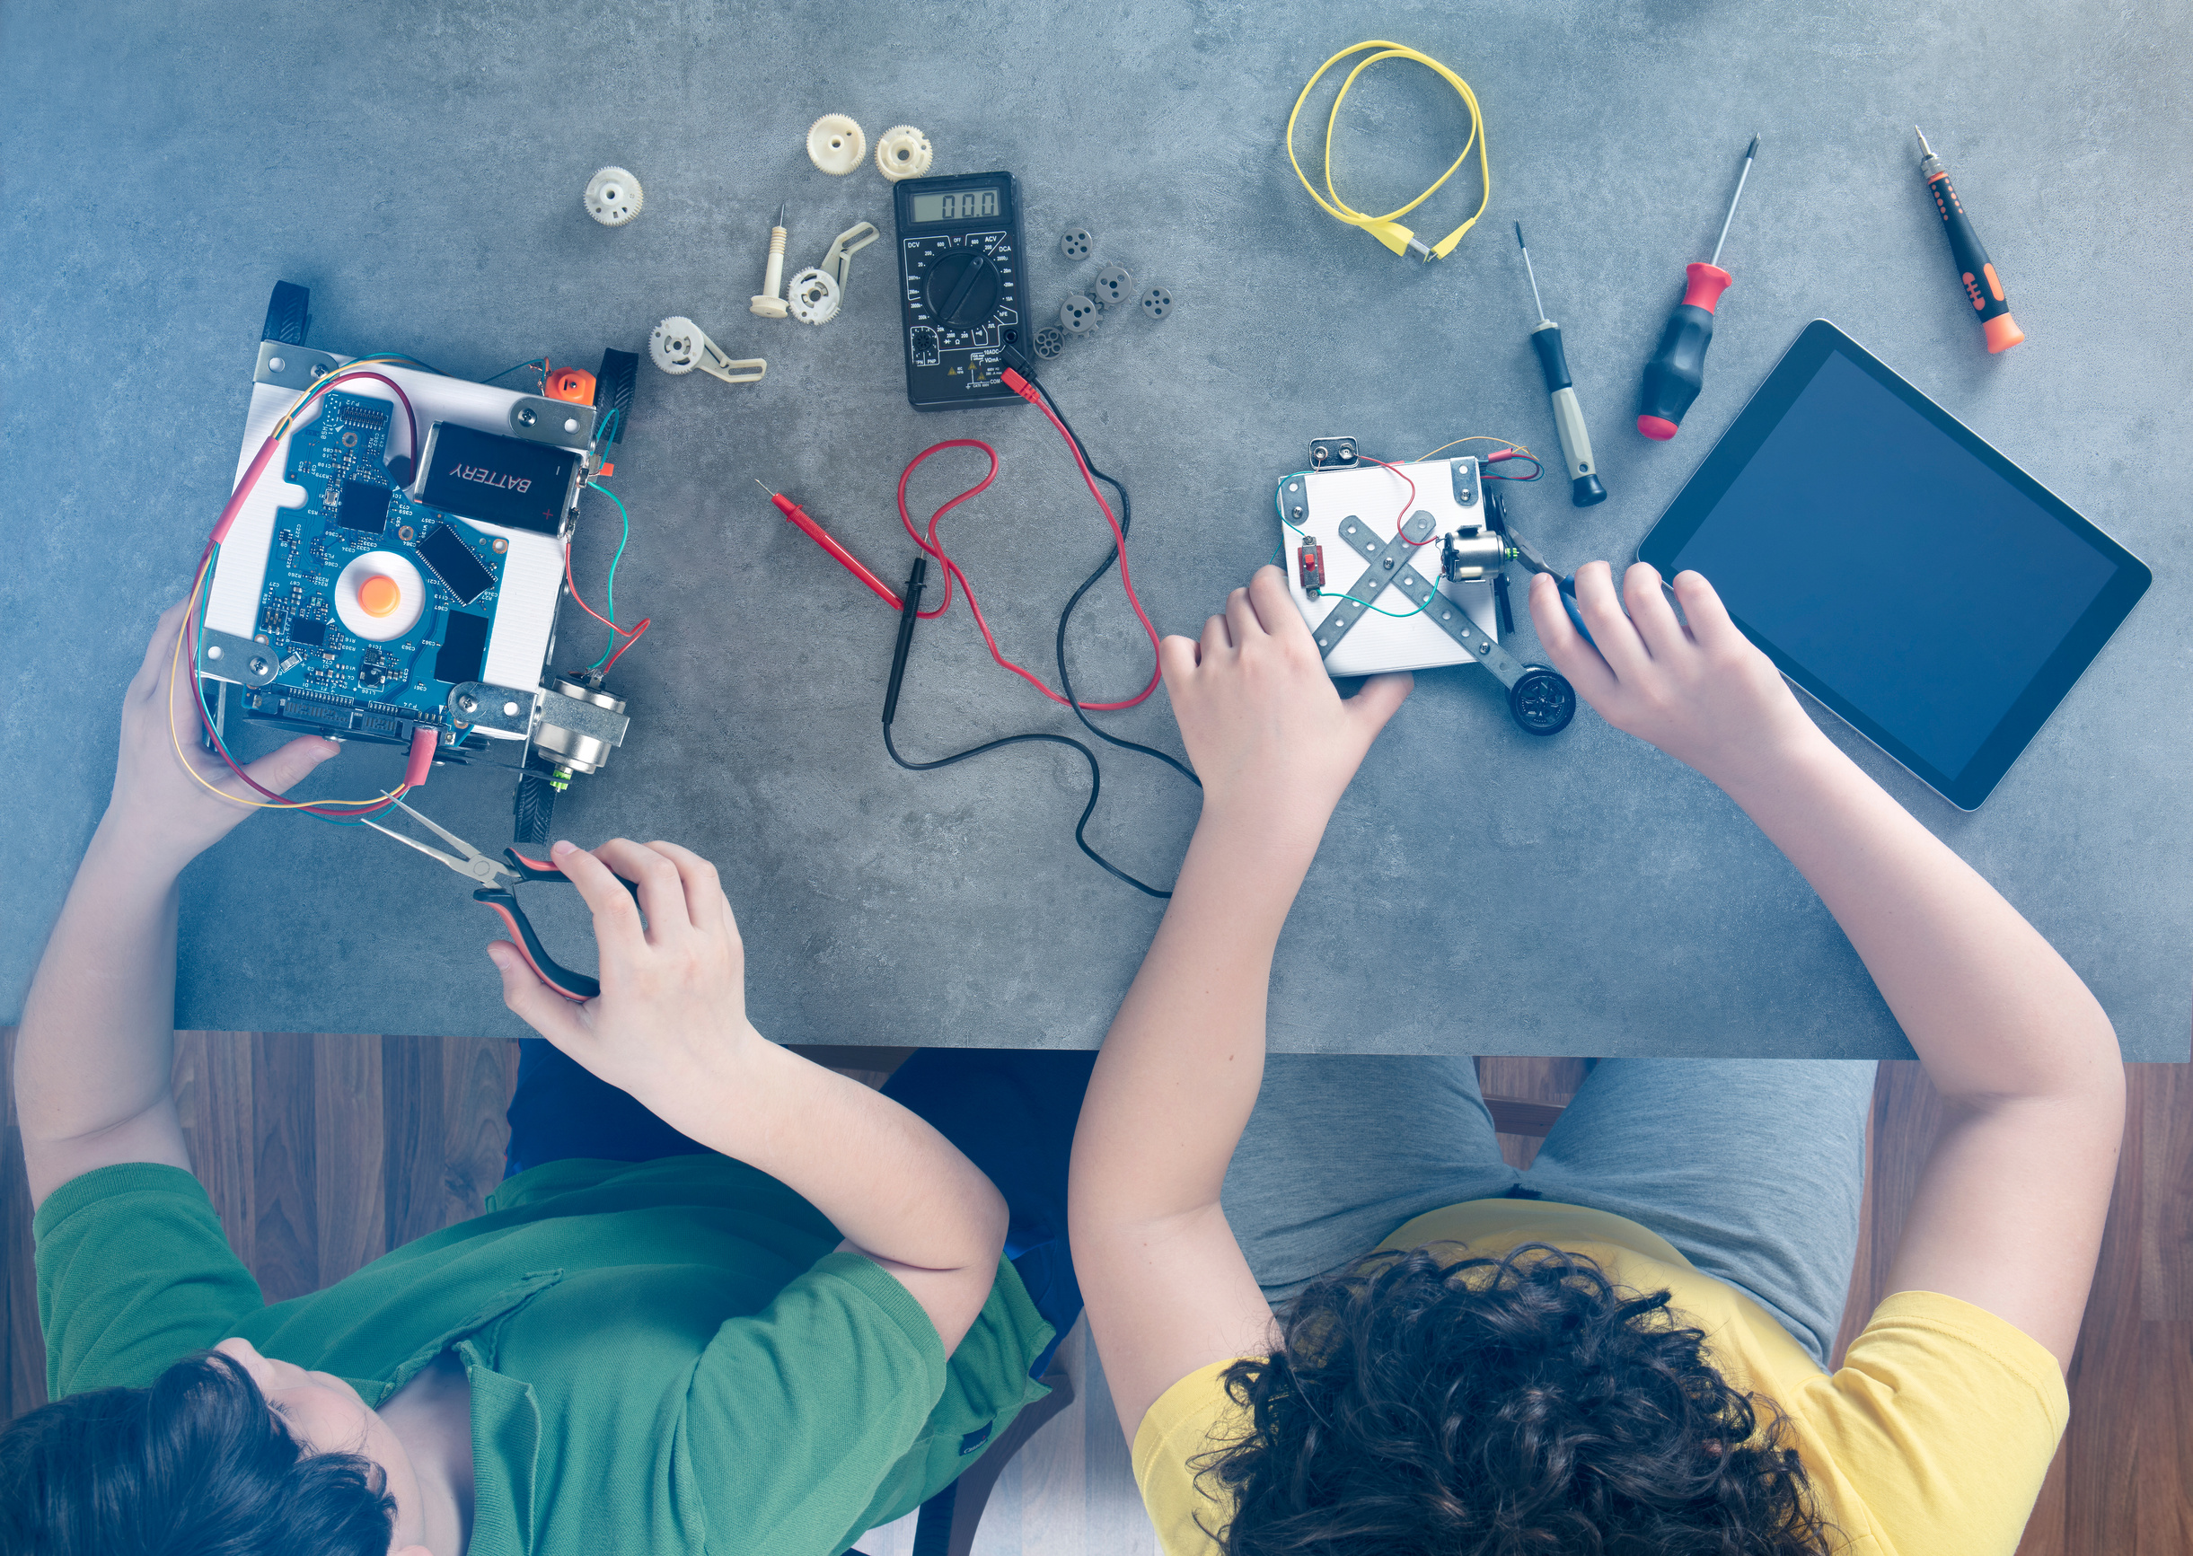



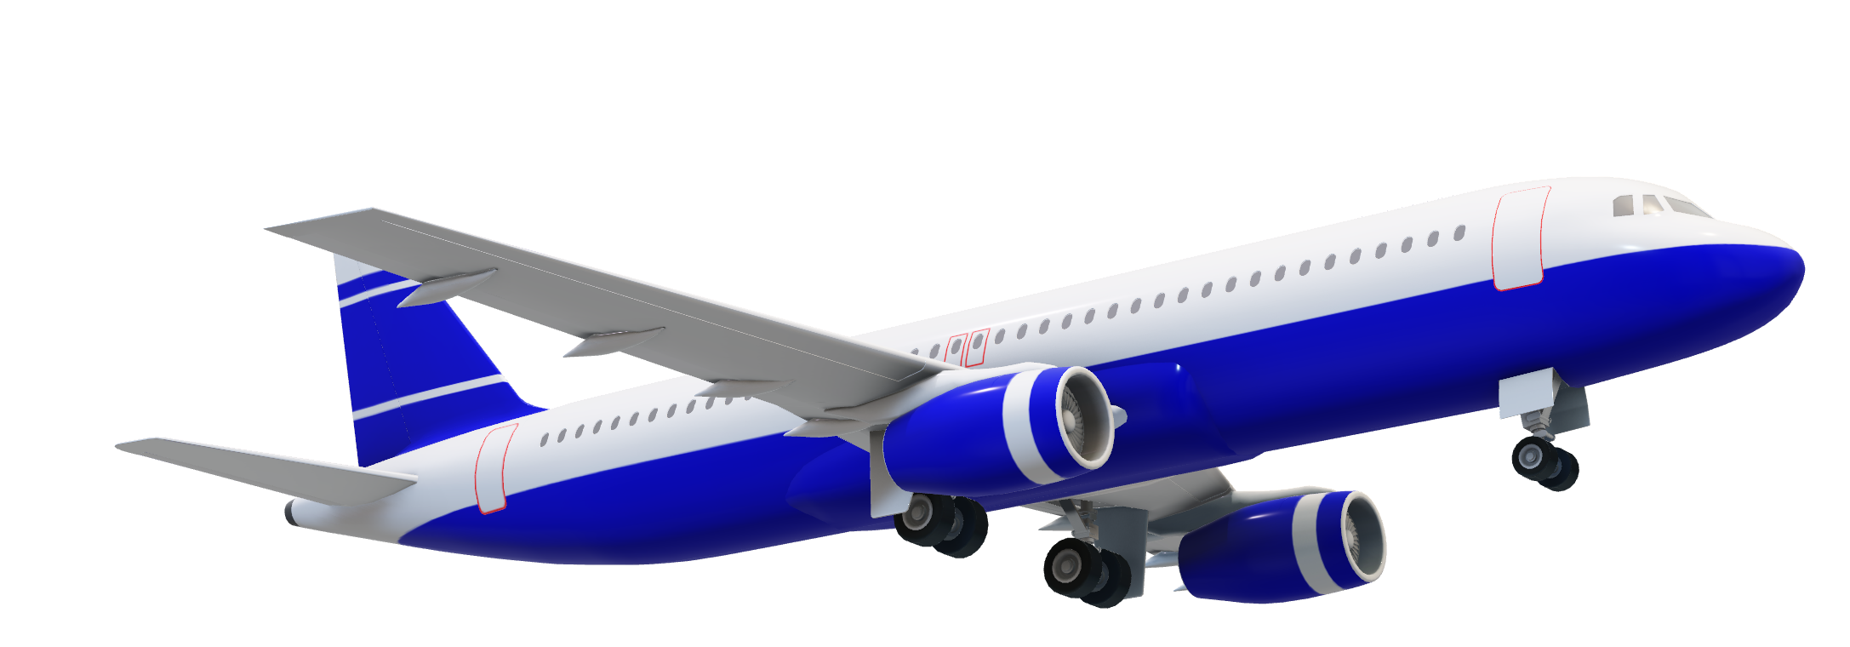

Table of Content
Problem statement!
About Team
Budget
Problem Statement
End of Presentation
Main Content
Project
TimeLine

Slide 5





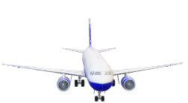
HOME
TITLE
CONTENT
TIMELINE
BUDGET
Team
Team Members:-
AI Integration & programming!
Saurabh Singh
Poojan Mehta
@100rabx23
@poojan_mehta
Diploma Computer Engineering
Diploma Computer Engineering
@saurabhx2004

Slide 6
HOME
Team
CONTENT
TIMELINE
BUDGET
Team Members:-
AI Integration & programming!

Slide 7


HOME
Team
CONTENT
TIMELINE
BUDGET
Team Members:-
IoT & Equipment management
Ashish Bind
Abdullah Chaudhary
@ashish_Bind
@abd_chaudhary
Diploma Computer Engineering
Diploma Computer Engineering

Slide 8
HOME
Team
CONTENT
TIMELINE
BUDGET
Team Members:-
IoT & Equipment management
@abd_chaudhary
@ashish_Bind
Ashish Bind
Abdullah Chaudhary

Slide 9


HOME
Team
CONTENT
TIMELINE
BUDGET
Team Members:-
Designing & assemble
Saood Khan
Parthiv Panchal
@khan_saood
@panchal_parthiv
Diploma Computer Engineering
Diploma Computer Engineering
@abd_chaudhary
@ashish_Bind
Ashish Bind
Abdullah Chaudhary

Slide 10
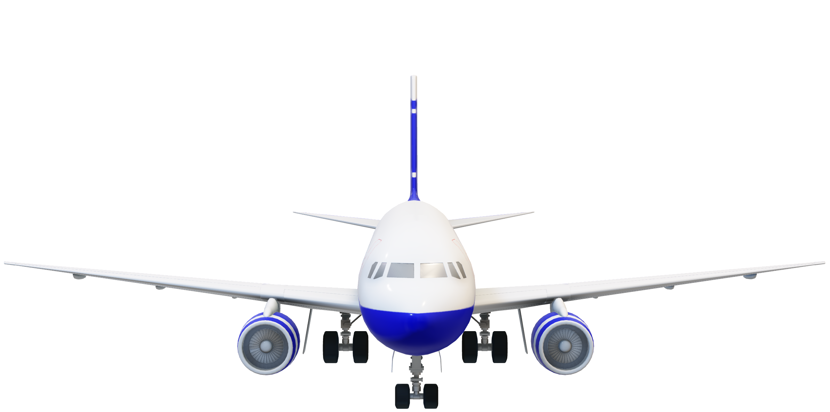

HOME
Problem Statement
TIMELINE
BUDGET
Team Members:-
Designing & assemble
Parthiv Panchal
@panchal_parthiv
Problem statement!
Saood Khan
@khan_saood
@abd_chaudhary
@ashish_Bind
Ashish Bind
Abdullah Chaudhary

Slide 11
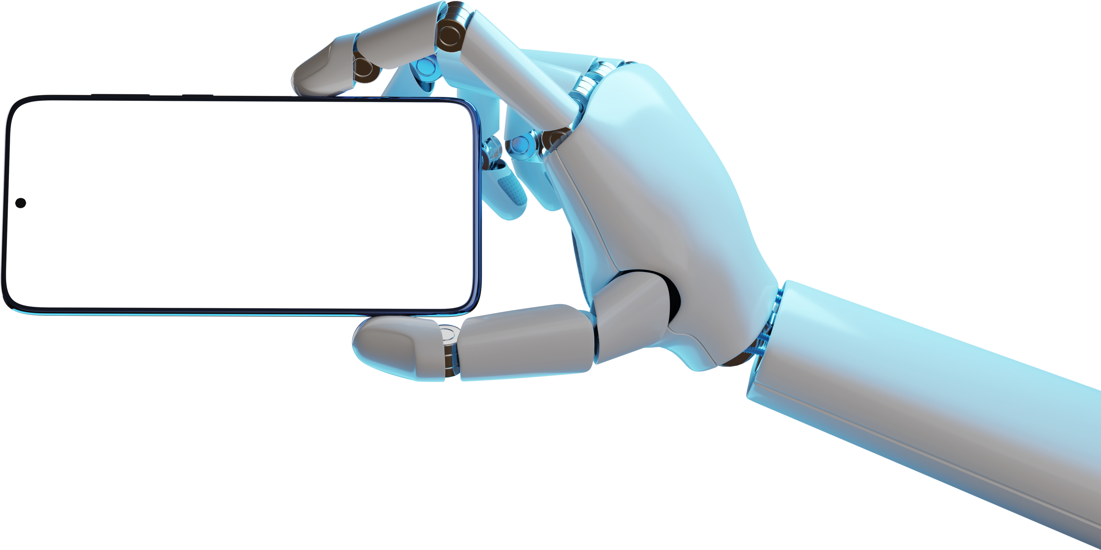

Problem statement!
The need of modern world is to have a solution that not only keeps your home safe but also respects your privacy, can evolve with the latest technologies, and fits well into the dynamic lifestyles of today's households.
So we are introducing
So, what’s a solution??
Current home security and automation systems lack the intelligence needed to keep up with the changing needs of modern households. They struggle with real-time monitoring, proactive security measures, and user-friendly communication. Basic features like facial recognition, abnormality detection, and integration with other smart home devices are often missing. Homeowners are left without a comprehensive solution that ensures privacy, security, and adaptability in today's fast-paced technological environment. There's a clear need for an advanced system that leverages AI, robotics, and IoT to provide a smarter, more user-friendly home security and automation experience.

Slide 12
Problem statement!
Description:-
Current home security and automation systems lack the intelligence needed to keep up with the changing needs of modern households. They struggle with real-time monitoring, proactive security measures, and user-friendly communication. Basic features like facial recognition, abnormality detection, and integration with other smart home devices are often missing. Homeowners are left without a comprehensive solution that ensures privacy, security, and adaptability in today's fast-paced technological environment. There's a clear need for an advanced system that leverages AI, robotics, and IoT to provide a smarter, more user-friendly home security and automation experience.
So we are introducing
So, what’s a solution??

Slide 13
Current home security and automation systems lack the intelligence needed to keep up with the changing needs of modern households. They struggle with real-time monitoring, proactive security measures, and user-friendly communication. Basic features like facial recognition, abnormality detection, and integration with other smart home devices are often missing. Homeowners are left without a comprehensive solution that ensures privacy, security, and adaptability in today's fast-paced technological environment. There's a clear need for an advanced system that leverages AI, robotics, and IoT to provide a smarter, more user-friendly home security and automation experience.
Problem statement!
So, what’s a solution??
So we are introducing

Slide 14
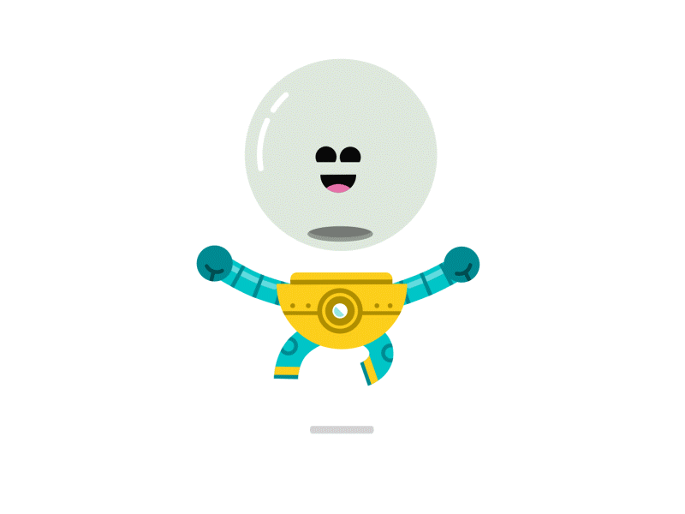
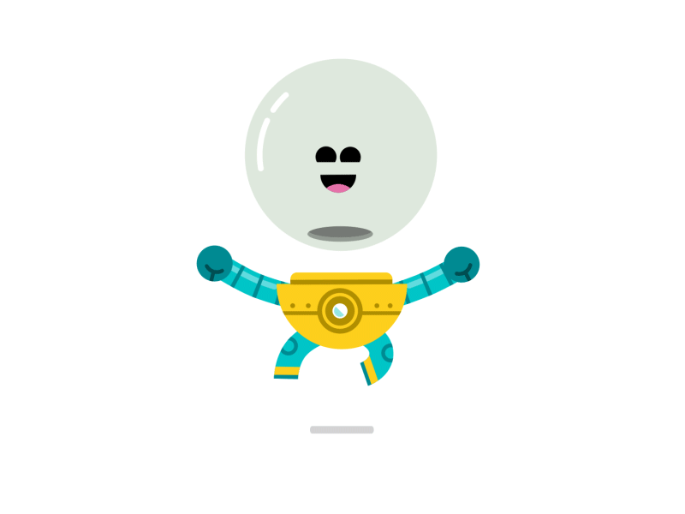

So we are introducing
ABHAR

Slide 15
So we are introducing
ABHAR
Ai-Based Home Assistant Robo!

Slide 16
So we are introducing
ABHAR
Ai-Based Home Assistant Robo!

Slide 17


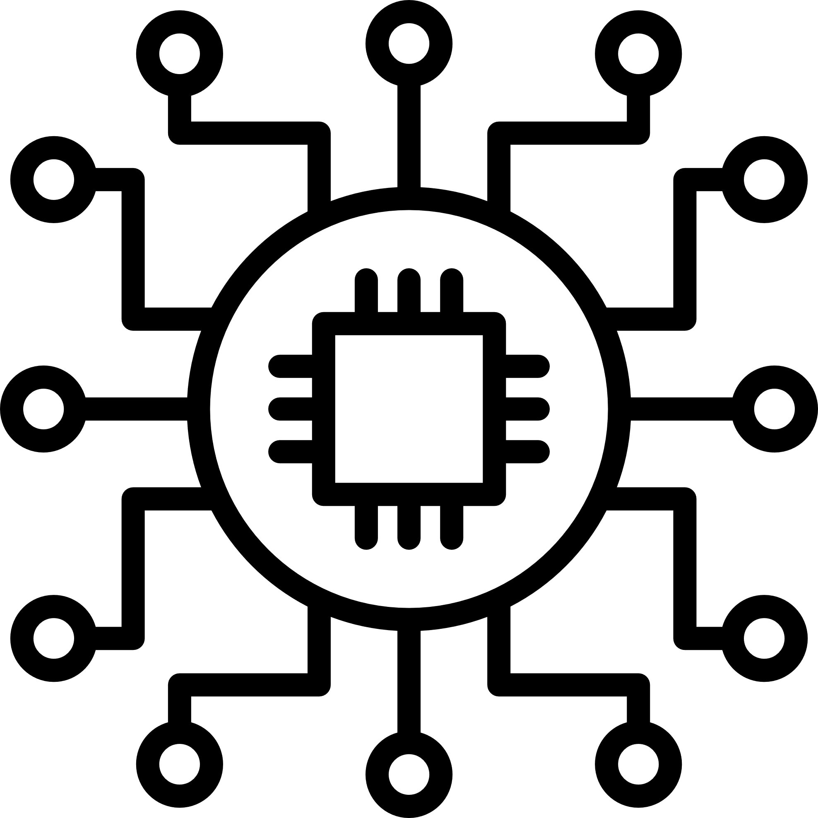

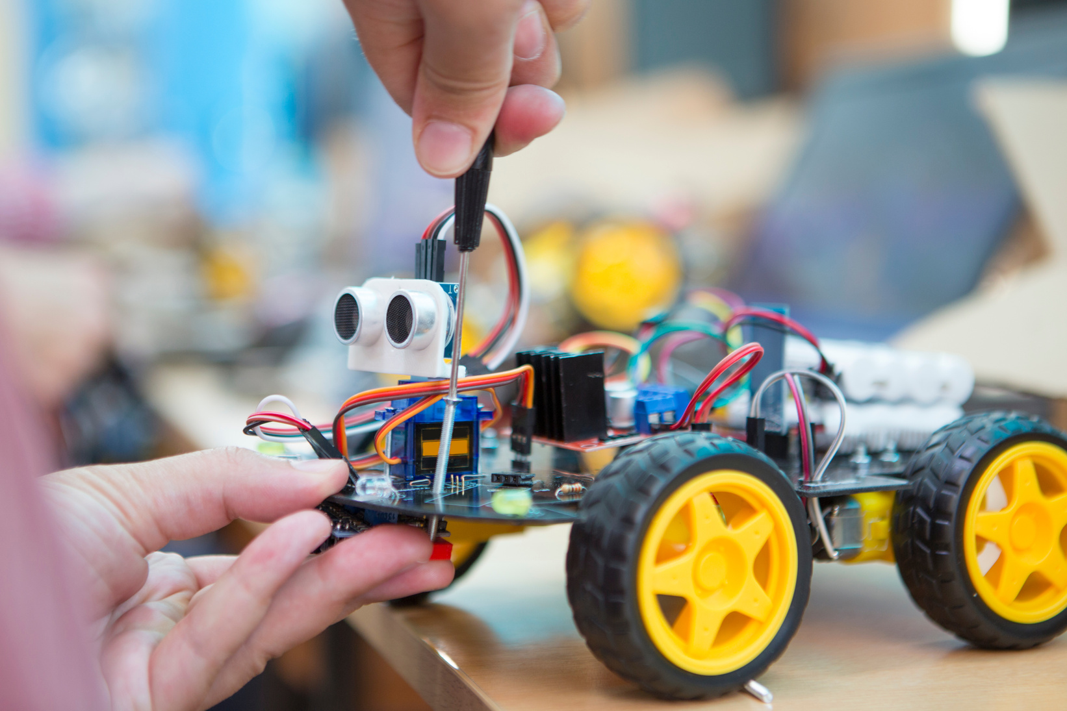
Main Features
Interaction in
Native Language
Face
Recognition
Smart Home Automation
IoT
Integration

Slide 18
Face
Recognition
Main Features
Interaction in
Native Language
Smart Home Automation
IoT
Integration

Slide 19
Main Features
Interaction in
Native Language
Face
Recognition
Smart Home Automation
IoT
Integration

Slide 20
Main Features
Interaction in
Native Language
Face
Recognition
IoT
Integration
Smart Home Automation

Slide 21
Main Features
Interaction in
Native Language
Face
Recognition
Smart Home Automation
IoT
Integration

Slide 22
Main Features
Interaction in
Native Language
Face
Recognition
Smart Home Automation
IoT
Integration

Slide 23
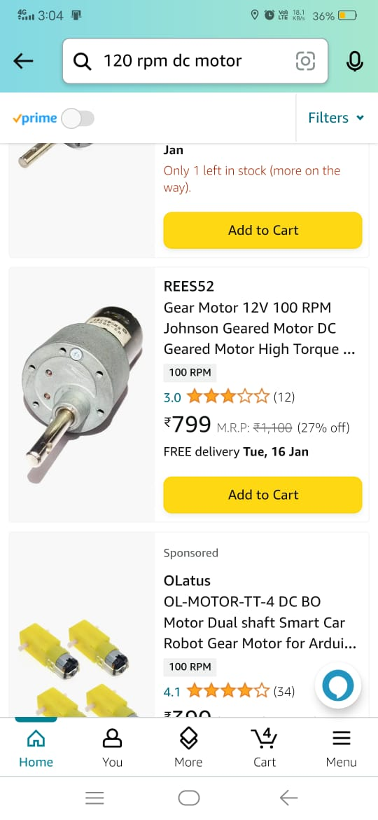
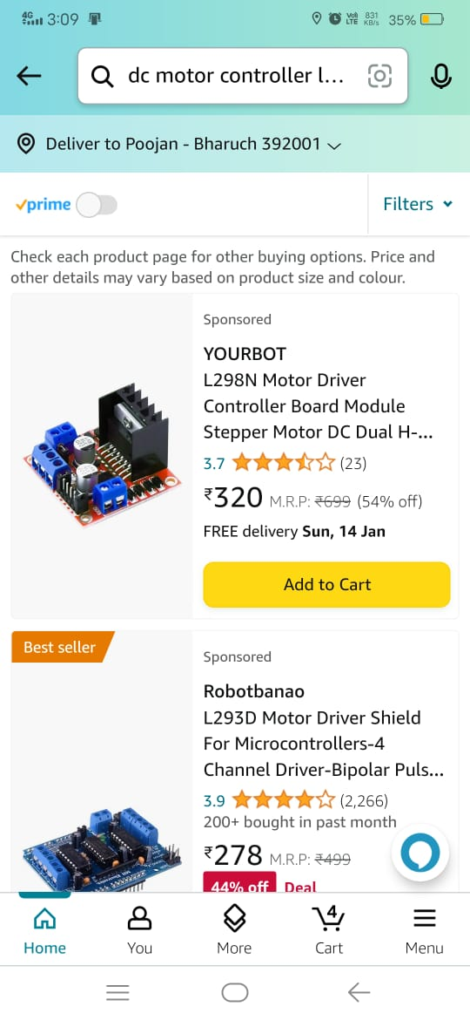
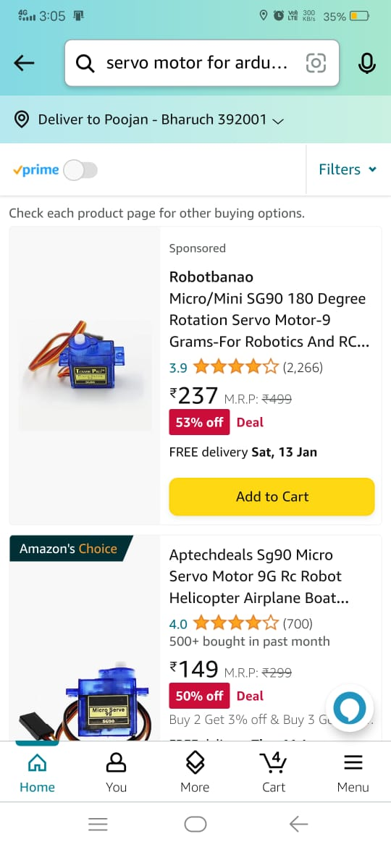
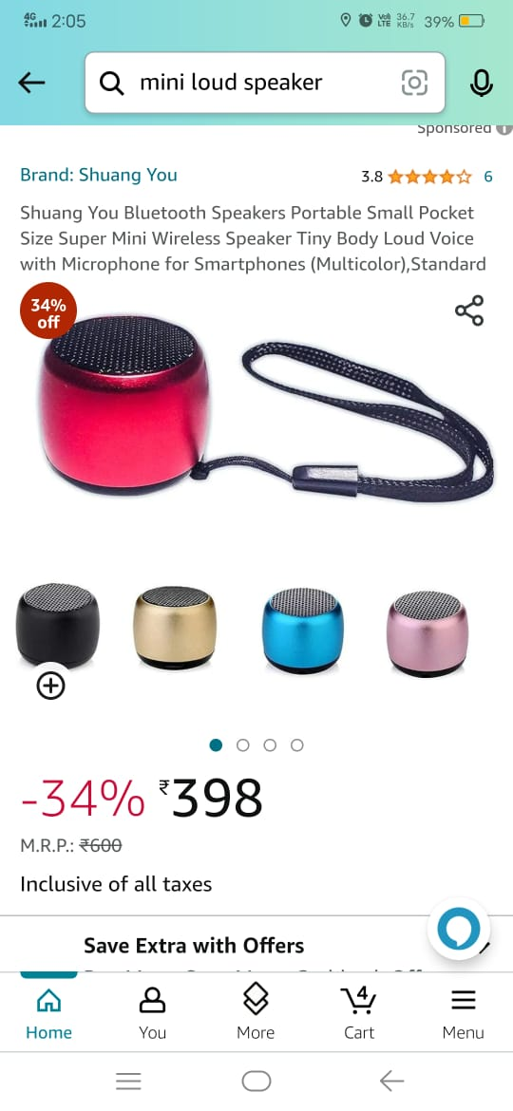
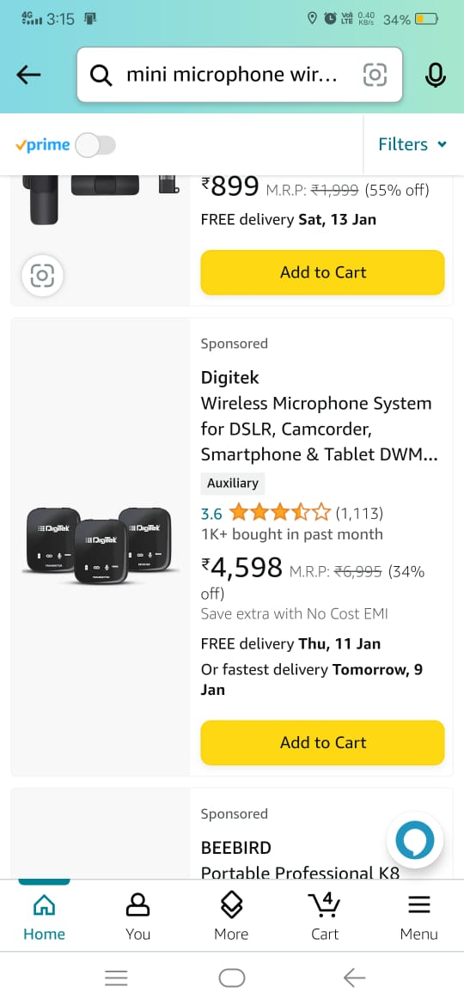
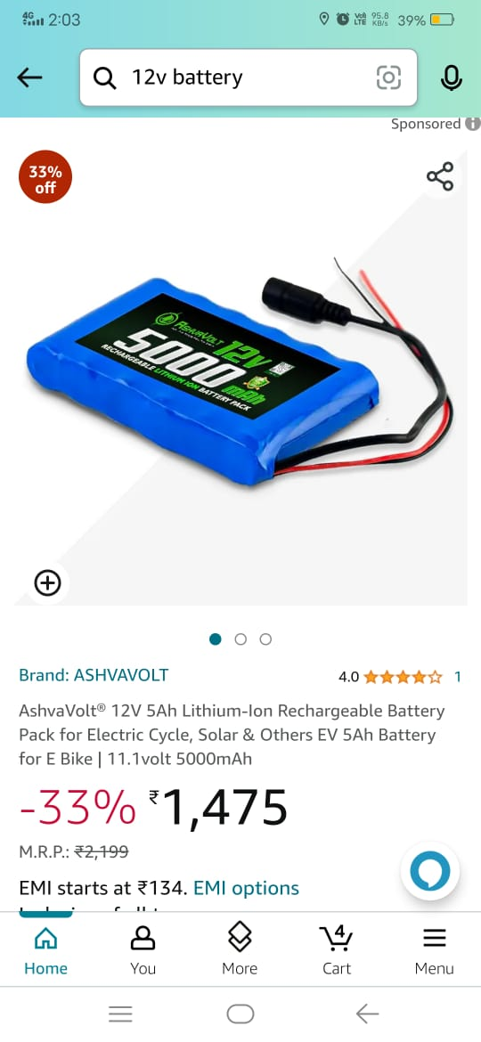
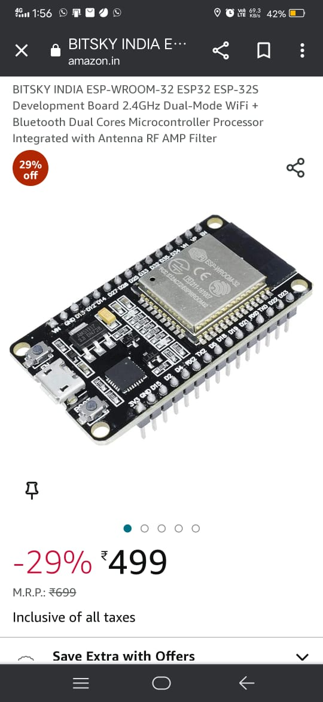
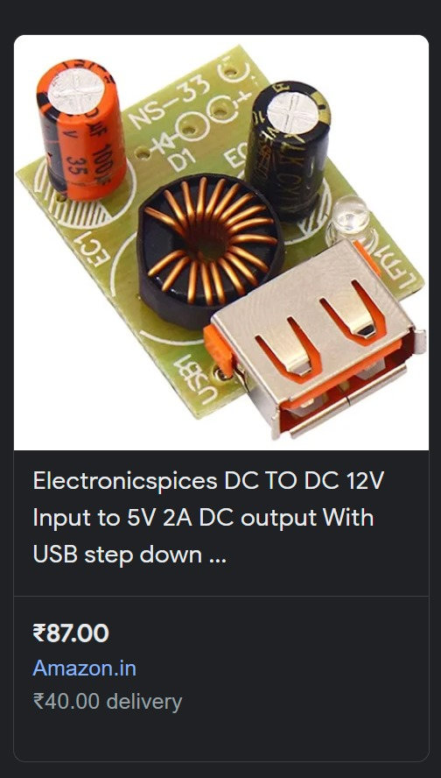
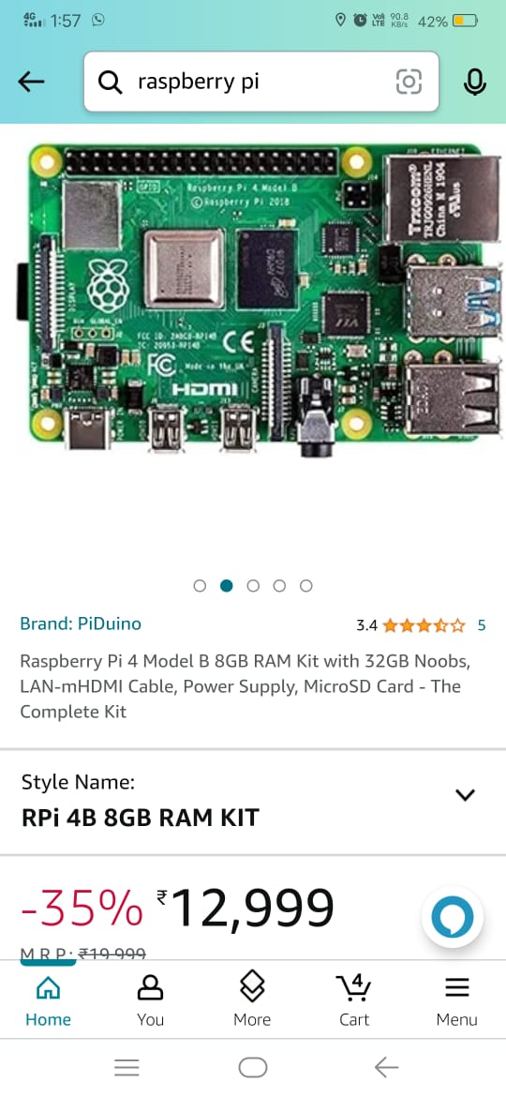
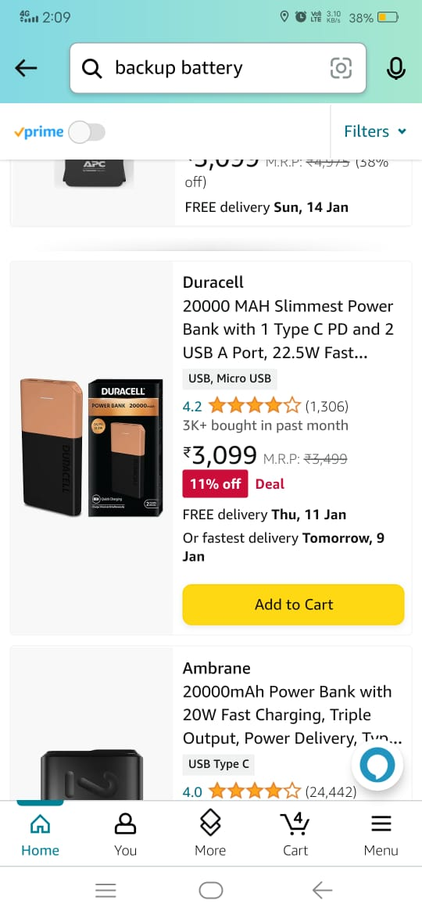
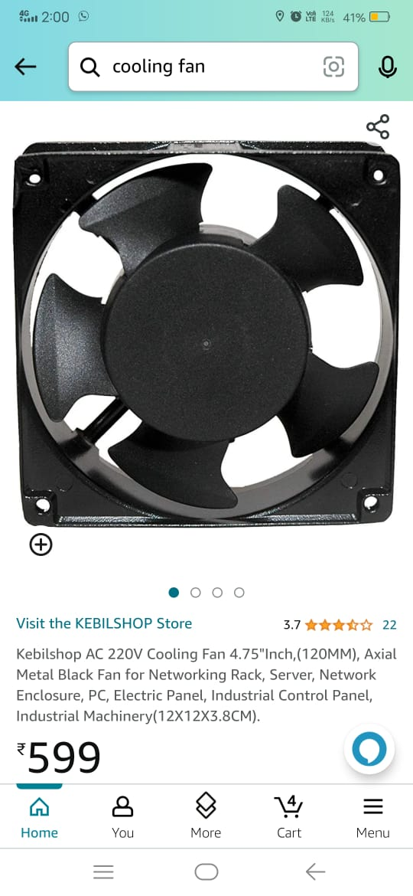
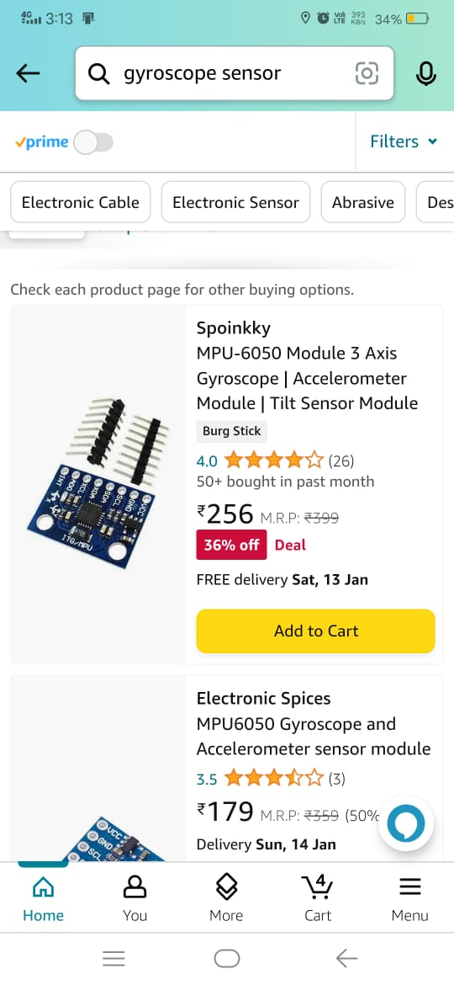
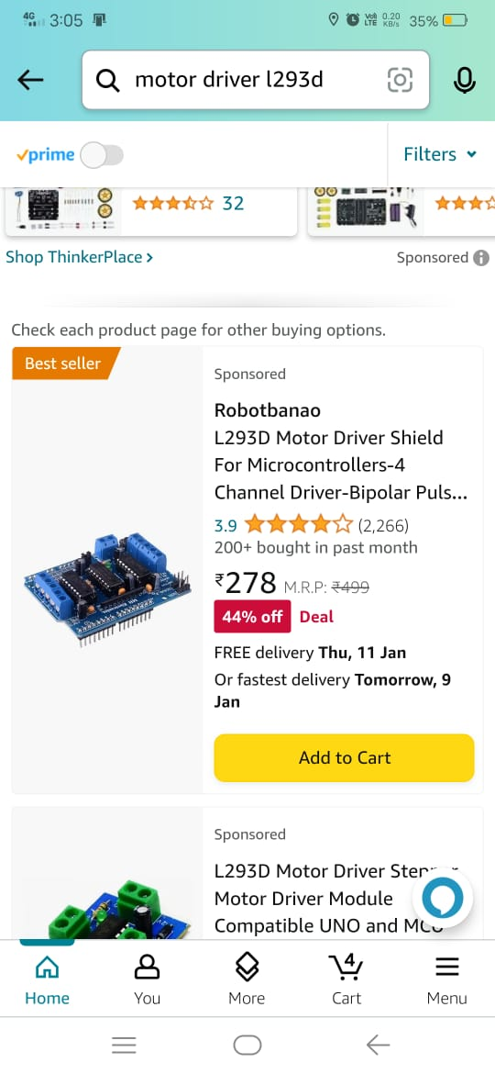
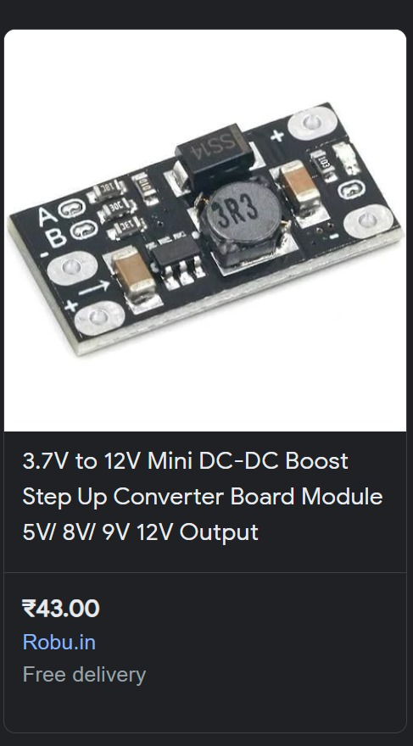
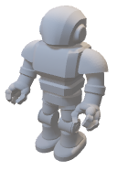
Required Components!
Interaction in
Native Language
Face
Recognition
Smart Home Automation
IoT
Integration

Slide 24
Required Components!
Interaction in
Native Language
Face
Recognition
ESP 82
Smart Home Automation
IoT
Integration

Slide 25
Required Components!
Interaction in
Native Language
Face
Recognition
L298N Motor Driver
Smart Home Automation
IoT
Integration

Slide 26
Required Components!
Interaction in
Native Language
Face
Recognition
Heart of our Robo
Microcontroller
Raspberry pi
Smart Home Automation
IoT
Integration

Slide 27
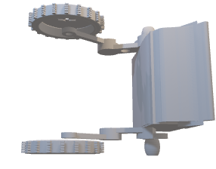
Required Components!
Interaction in
Native Language
Face
Recognition
Gyroscope
Smart Home Automation
IoT
Integration

Slide 28
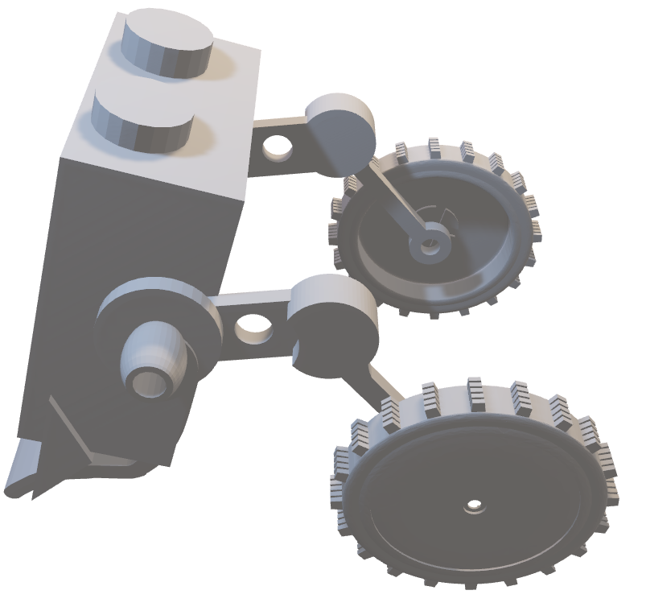
Required Components!
Interaction in
Native Language
Face
Recognition
What about
TimeLine and Budget?
Smart Home Automation
IoT
Integration

Slide 29
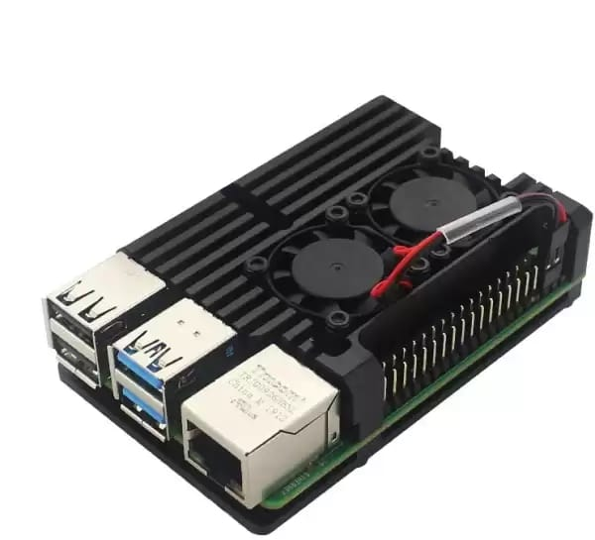
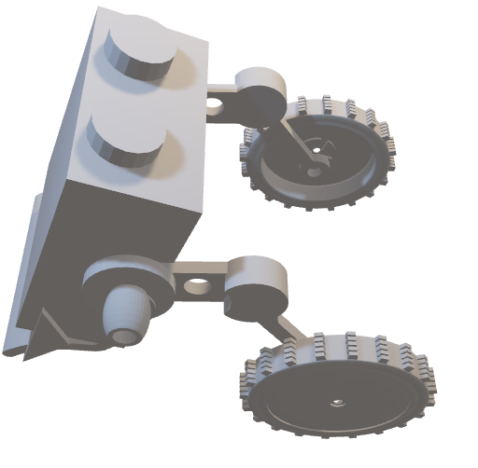
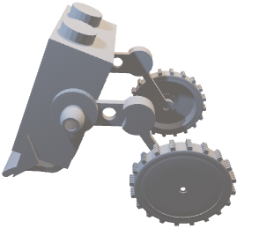
Required Components!
Interaction in
Native Language
Face
Recognition
What about
TimeLine and Budget?
Smart Home Automation
IoT
Integration

Slide 30
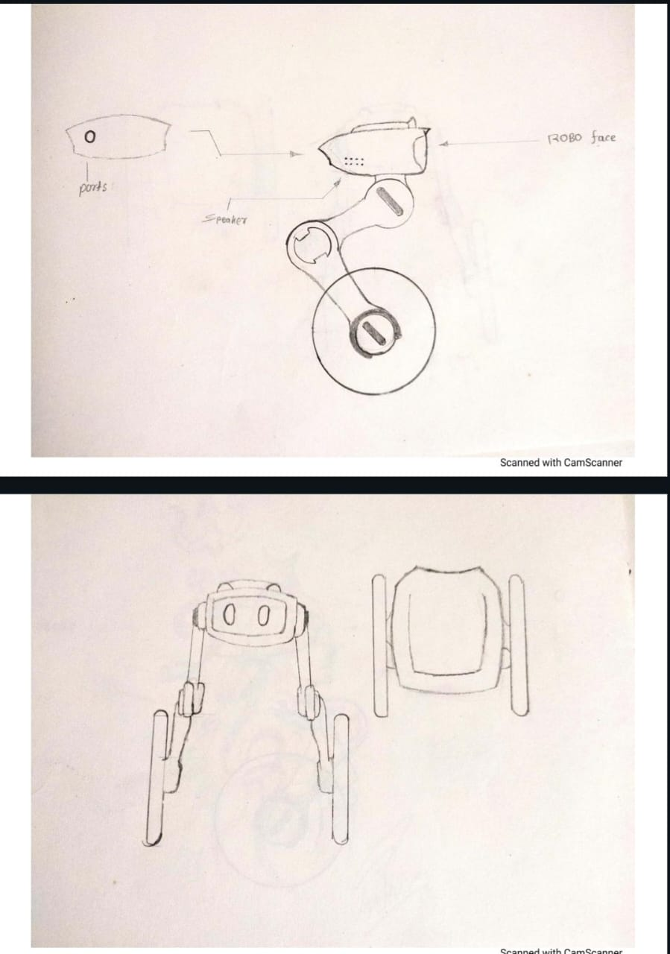
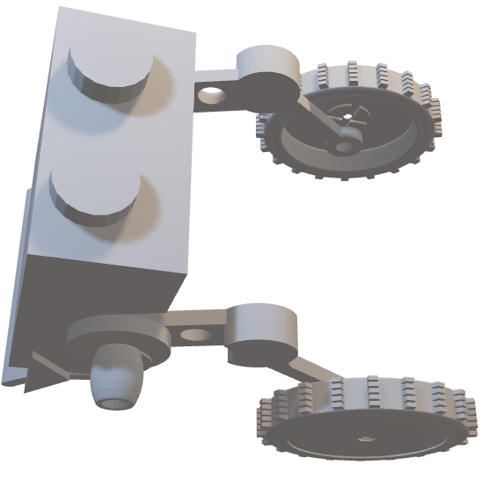
Required Components!
What about
TimeLine and Budget?
Interaction in
Native Language
Face
Recognition
2 WEEKS
More Research & Studies
Smart Home Automation
IoT
Integration

Slide 31
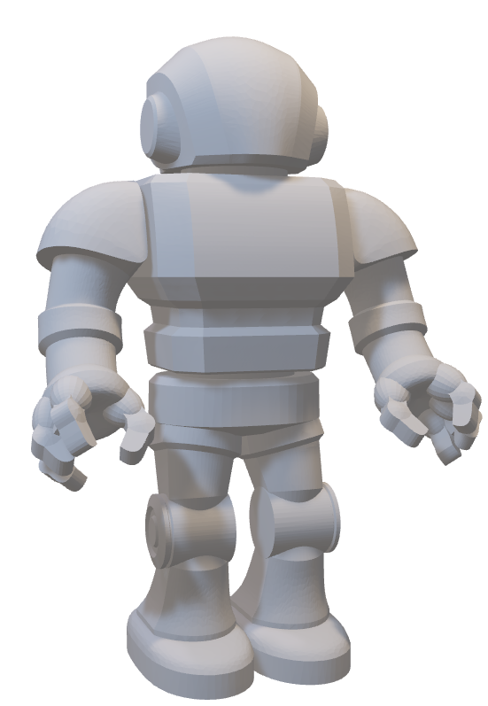
How our robot will be look like?
What about
TimeLine and Budget?
Interaction in
Native Language
Face
Recognition
2 WEEKS
More Research & Studies
Smart Home Automation
IoT
Integration

Slide 32
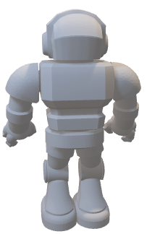
TimeLine
2 WEEKS
2 WEEKS
4 WEEKS
4 WEEKS
4 WEEKS
4 WEEKS
More Research
Components Order
Components Arrangement
Integration of AI & ML
Create a Working Model
Testing & debuggging

Slide 33
TimeLine
4 WEEKS
4 WEEKS
2 WEEKS
2 WEEKS
Components Arrangement
4 WEEKS
4 WEEKS
4 WEEKS
4 WEEKS
Components Arrangement
Components Arrangement
More Research & Studies
Components Order
Integration of AI & ML
Create a Working Model
Testing & debuggging

Slide 34
TimeLine
4 WEEKS
4 WEEKS
2 WEEKS
2 WEEKS
4 WEEKS
4 WEEKS
4 WEEKS
4 WEEKS
Components Arrangement
Integration of AI & ML
Components Order
Components Arrangement
Testing & debugging
Create a Working Model
Testing & debuggging
More Research & Studies zzz

Slide 35
TimeLine
4 WEEKS
4 WEEKS
4 WEEKS
4 WEEKS
4 WEEKS
2 WEEKS
Testing & debugging
Components Arrangement
Create a Working Model
2 WEEKS
Integration of AI & ML
Testing & debugging
More Research & Studies
Components Order

Slide 36
TimeLine
4 WEEKS
4 WEEKS
4 WEEKS
4 WEEKS
2 WEEKS
4 WEEKS
Components Arrangement
2 WEEKS
Create a Working Model
Testing & debugging
Testing & debugging
Integration of AI & ML
More Research & Studies
Components Order

Slide 37
TimeLine
4 WEEKS
4 WEEKS
4 WEEKS
4 WEEKS
2 WEEKS
Create a Working Model
Components Arrangement
Integration of AI & ML
4 WEEKS
Testing & debugging
2 WEEKS
Components Order
More Research & Studies
Integration of AI & ML

Slide 38

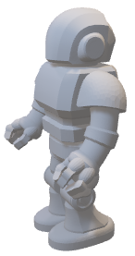
TimeLine
2 WEEKS
2 WEEKS
2 WEEKS
4 WEEKS
4 WEEKS
4 WEEKS
4 WEEKS
More Research & Studies
Components Order
Components Arrangement
Integration of AI & ML
Create a Working Model
Testing & debuggging
Budget

Slide 39

Budget
₹ 60,000

Slide 40

Budget
Raspberry pi = ₹12,000
Mechanics = ₹4500
Metal case cooling for Raspberry pi = ₹1000
Physical Storage as well as Cloud Storage = ₹5000
Networking = ₹8500
wiring Equipment = ₹1000
MQTT server = ₹2000
Other Essential Machine = ₹4000
3D Printed Objects for Robot design:- ₹9000
Testing = ₹ 15,000
₹ 62,000

Slide 41

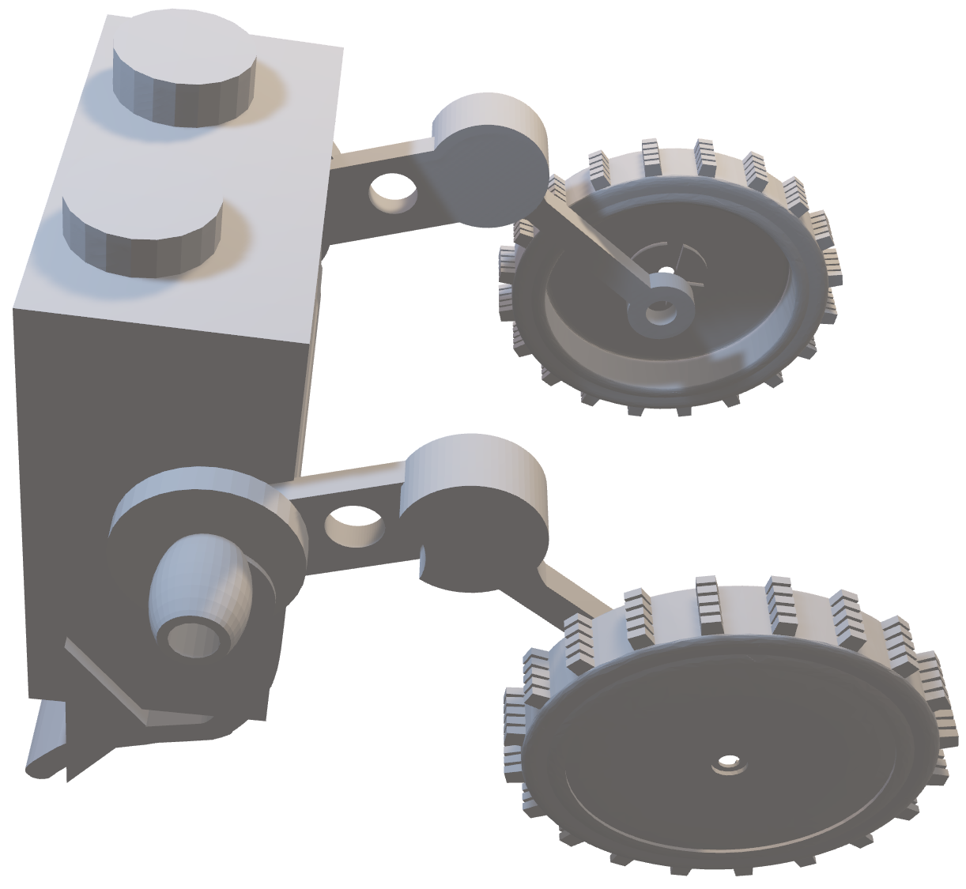
Thank you!
For full documentation

Slide 42
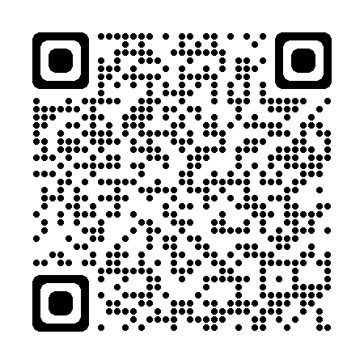

Thank you!
For full documentation

